Slide 1
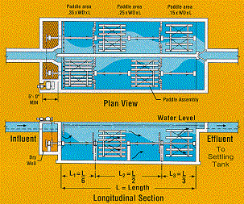
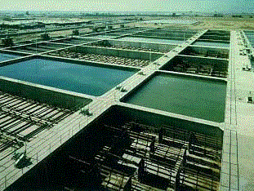
Mechanical Flocculation
Particle collisions caused by gentle stirring
Advantage
energy dissipation rate can be varied independent of flow rate
simple design
Disadvantage
potential short circuiting (some fluid moves quickly from inlet to outlet)
moving parts in a wet environment
Highly non-uniform energy dissipation rate

Slide 2
Recommended G and Gθ values: Turbidity or Color Removal (Mechanical flocculators)
Guidelines are given without equations
This is because we don’t yet understand the physics of flocculation
We would like to know WHY there is a difference between removing color (dissolved organics) and particles
Type | “Velocity gradient” (G) (1/s) | Gθ
Low turbidity, color removal | 20-70 | 50,000-250,000
High turbidity, solids removal | 70-180 | 80,000-190,000
Sincero and Sincero, 1996 Environmental Engineering: A Design Approach
Notes:
Cleasby, J. L., "Is Velocity Gradient a Valid Turbulent Flocculation Parameter?"
ASCE, Journal of Environmental Engineering, Vol. 110, No. 5, Oct.,
1984
http://dx.doi.org/10.1061/(ASCE)0733-9372(1984)110:5(875)
Why???

Slide 3
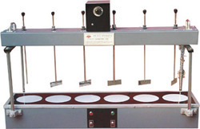
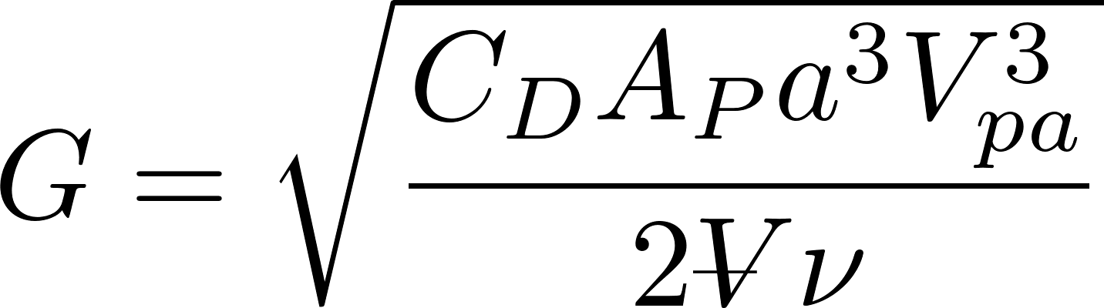
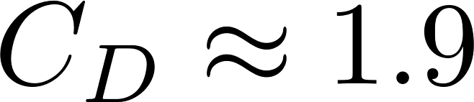
Mechanical Design: mixing with paddles
Ratio of relative to absolute velocity of paddles
Projected area of paddles
This equation does not account for the inefficiency that is the result of the non uniform distribution of energy dissipation in mechanical flocculators
Drag coefficient
“velocity gradient”
Reactor volume

Slide 4
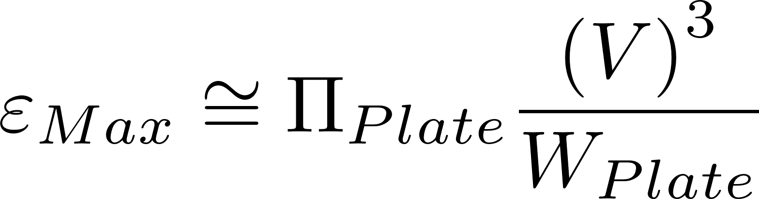
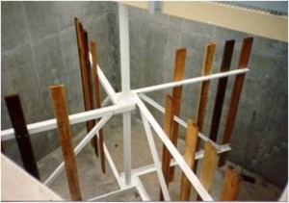
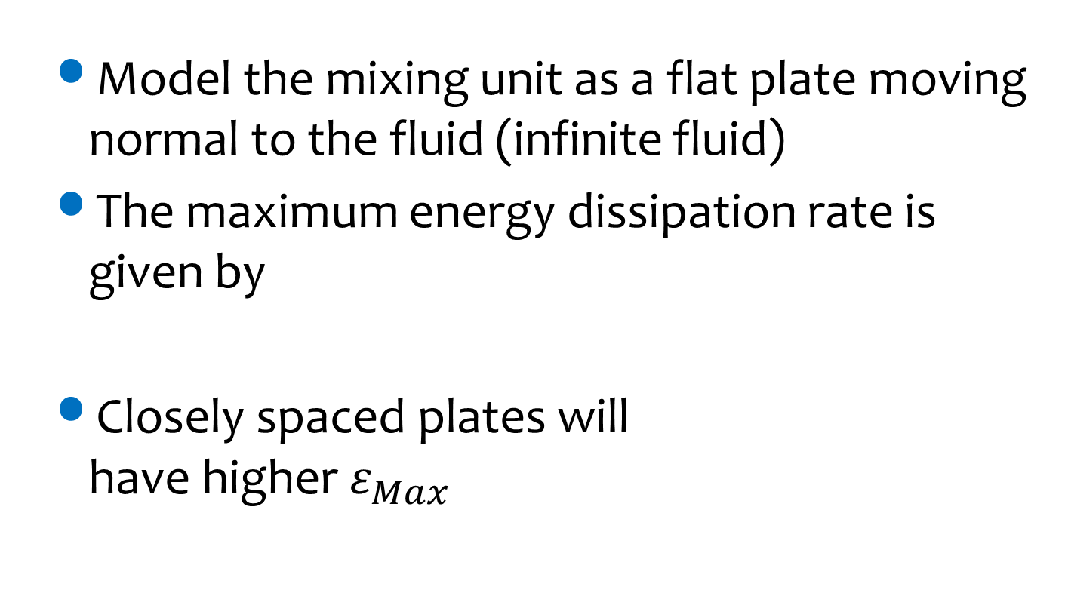
Mechanical Flocculators and Energy Dissipation Rate
Model the mixing unit as a flat plate moving normal to the fluid (infinite fluid)
The maximum energy dissipation rate is given by
Closely spaced plates will have higher $ε_{Max}$
V is relative velocity between fluid and plate

Slide 5
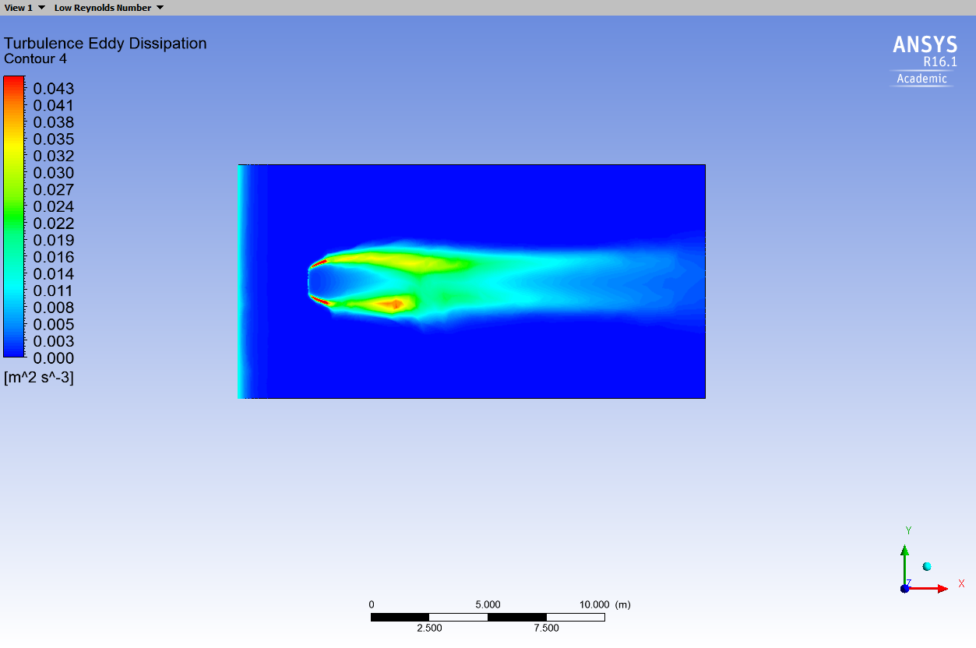
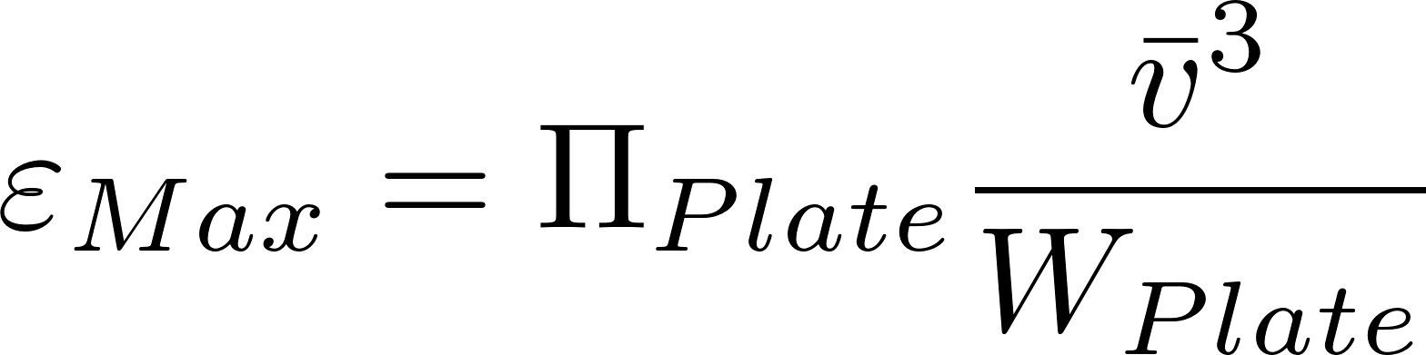
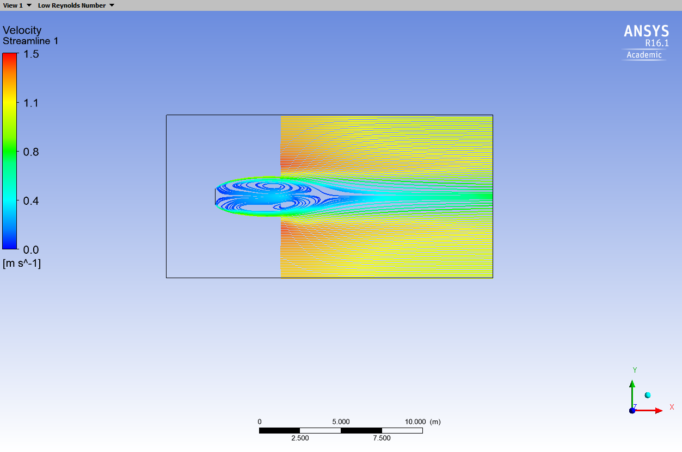
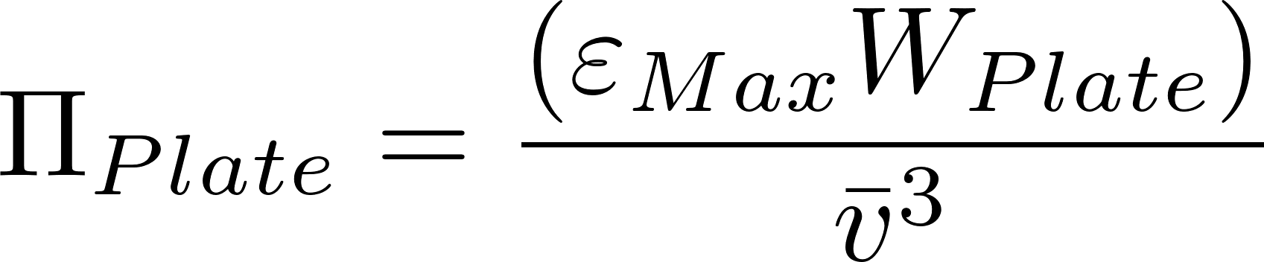
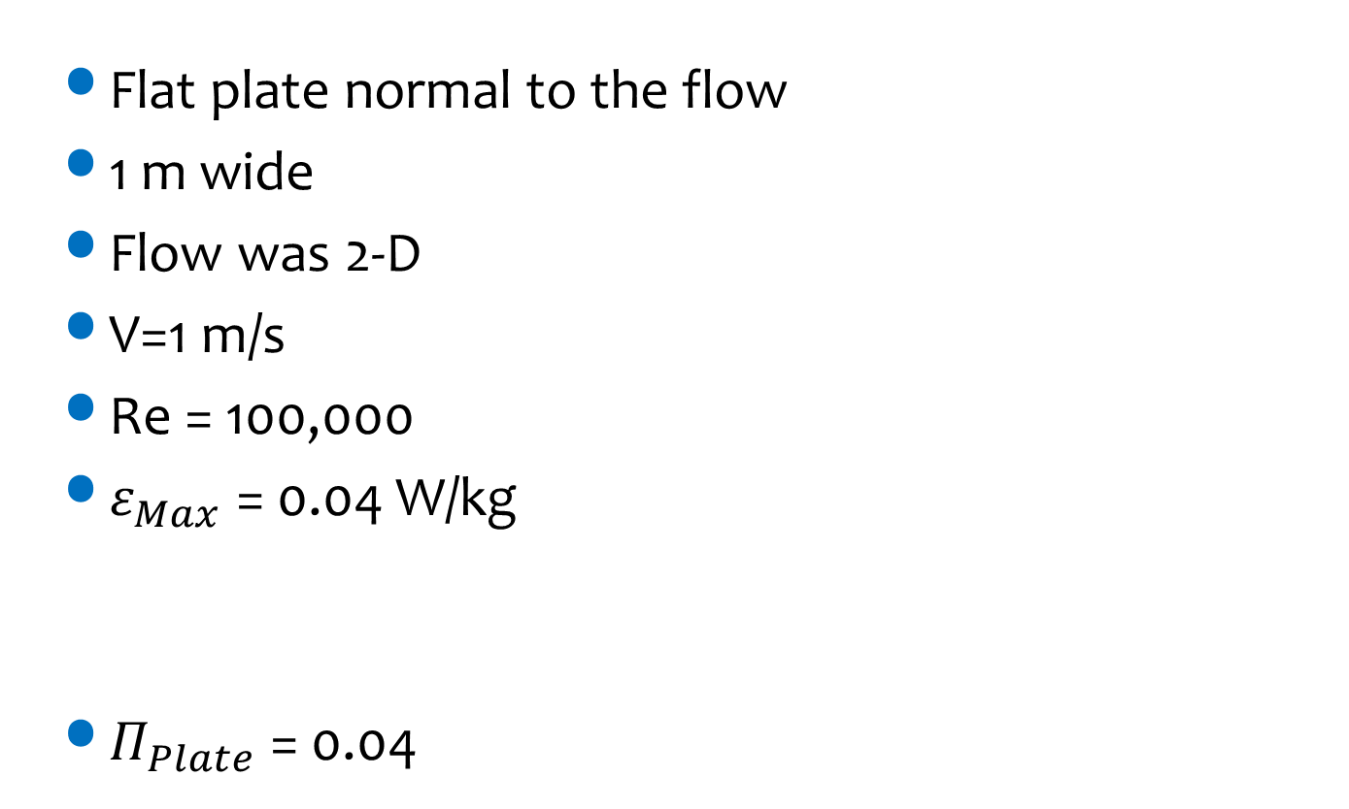
Computational Fluid Dynamics Analysis
Flat plate normal to the flow
1 m wide
Flow was 2-D
V=1 m/s
Re = 100,000
$ε_{Max}$ = 0.04 W/kg
$Π_{Plate}$ = 0.04
Energy dissipation rate
Streamlines
Notes:
Ariane Walker-Horn <avw27@cornell.edu> 2015
Calculate max based on this wake equation
Calculate average based on total energy input and reactor volume.

Slide 6
Mechanical Flocculators Summary
Waste (a small amount of) electricity
Require unnecessary mechanical components
Have a wide distribution of energy dissipation rates (highest in the wake of the paddles) that may break flocs
Have a wide distribution of particle residence times (completely mixed flow reactors)

Slide 7
Why aren’t hydraulic flocculators used more often?
Simple construction means that there aren’t any items that private companies (venders) can sell as specialized components
Consulting firms want to be able to pass the design responsibility off to a vendor
The presumed operation flexibility of mechanical flocculators (variable speed motor driving a slow mixing unit)
Poor documentation of design approach for hydraulic flocculators (special permission required to use in the US!)
Using electricity is cool, design innovation is suspect…
Prior to AguaClara we didn’t have a design algorithm for small flocculators based on the fundamental physics

Slide 8
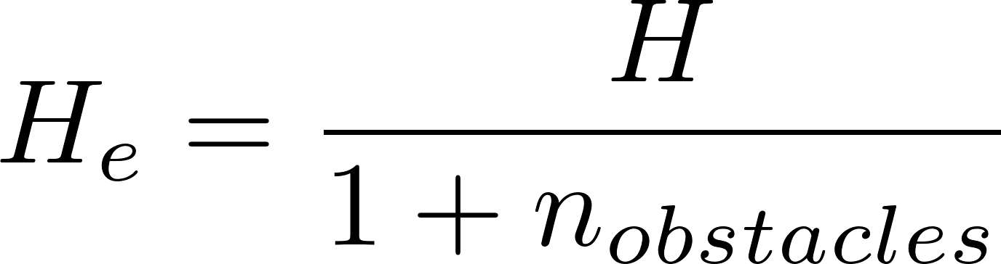
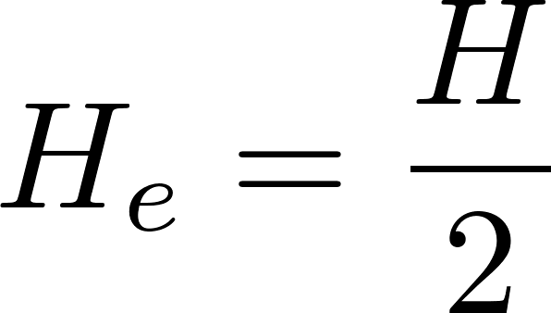

Obstacles and H_{e}/S vs H/S
H_{e} = H when there are no obstacles
H_{e}/S is what defines flocculator efficiency
1 obstacle
per baffle
No obstacles
Water
flow path
Obstacles
Notes:
This range of H/S is necessary to ensure that there is always a solution when switching from two expansions per baffle to one expansion per baffle.

Slide 9
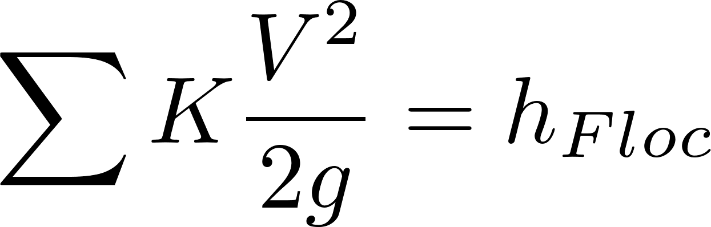
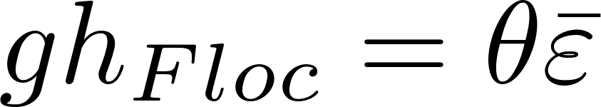
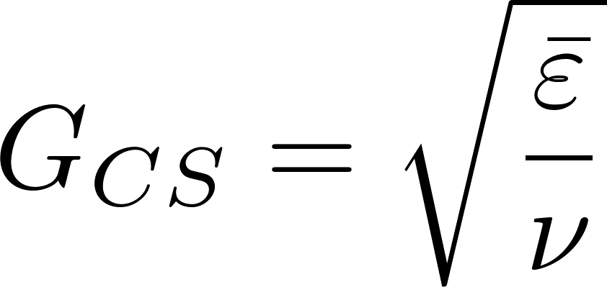
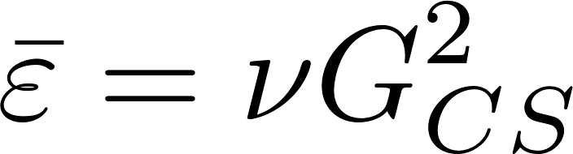
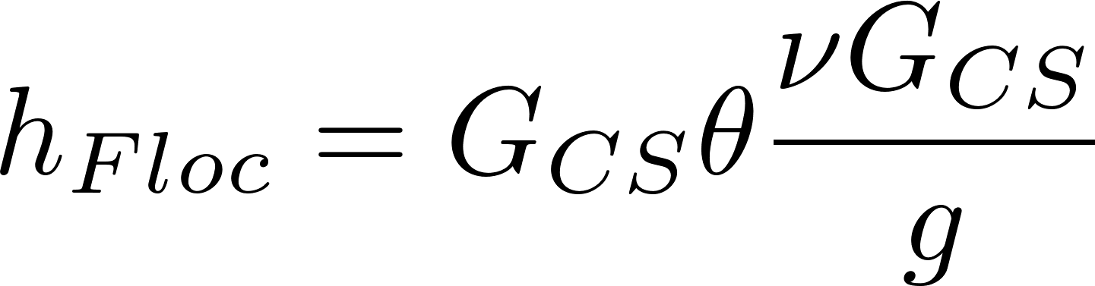
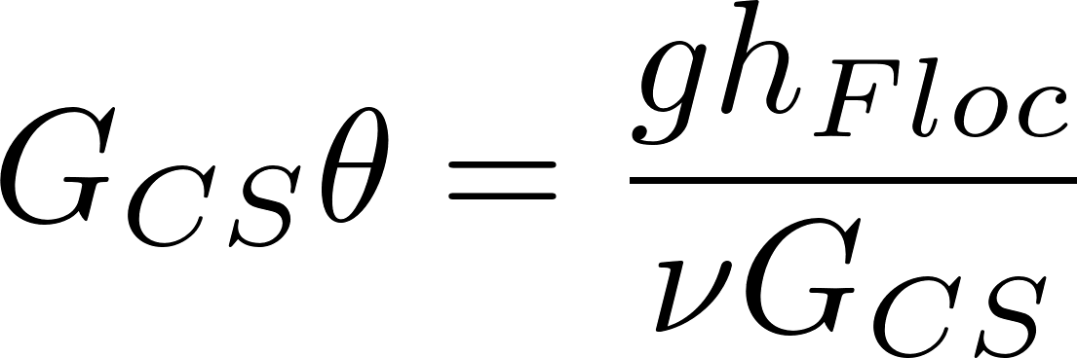
Energy use (head loss) in flocculation controls velocity gradient
Some of the kinetic energy in the flow contraction…
…is dissipated through turbulence and viscosity
Given the water temperature and hence viscosity the energy dissipation produces velocity gradients
Given a total fluid deformation (G_{CS}θ), the relationship between head loss and G_{CS} is
How can you achieve G_{CS}θ with less energy?
Notes:
Reduce velocity gradient and increase residence time! Can still achieve same total fluid deformation!

Slide 10
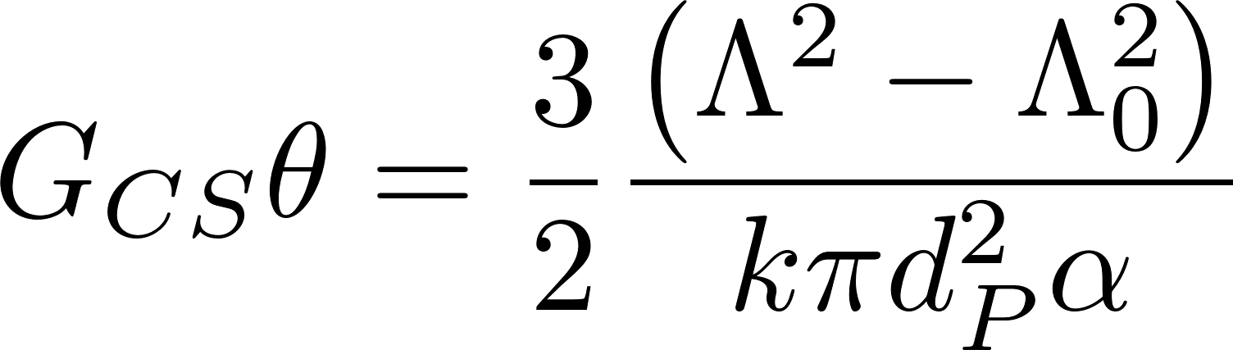
The design inputs for flocculation
We need collisions and thus G_{CS}θ is a logical design specification
We need to specify the maximum velocity gradient that will produce flocs large enough to be captured by the sedimentation tank (at the coldest temperature)
Higher G_{CS} means smaller flocs and more elevation drop (head loss) through flocculator
Notes:
This is in part because we don’t have a rational basis to choose the G value for flocculation. There is an economic impact of increasing head loss, so we use that constraint for now.

Slide 11
Possible constraints
Optimize plant layout
Water level leaving flocculator must match water level entering sedimentation tank (Always)
We want an efficient flocculator (controlled by H/S ratio)
Perhaps aim for flow passages that are close to square (W=S)
Notes:
Water levels must match! No pumps and no floc breakup

Slide 12
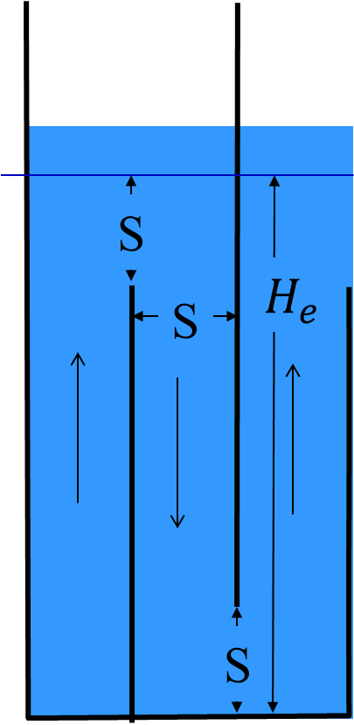
Bottom up Design Approach start with baffles and then the tank
Assume a water depth and a channel width
Design a baffle spacing and obstacle spacing to get an efficient H_{e}/S and the target G_{CS}
Calculate G_{CS}θ for one baffle spacing given your design
Calculate number of baffle spacings required to achieve design G_{CS}θ
Calculate length of channel required

Slide 13
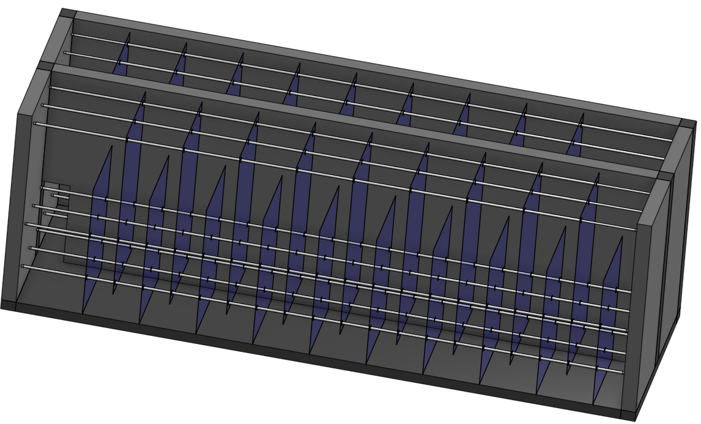
Top Down Design Approach start with the tank (our choice)
Calculate the required flocculator volume
Use plant layout constraints to select an optimal channel width
Design baffles and obstacles to create the target G_{CS} to set the baffle spacing
Fill the channels with baffles and don’t worry about a little extra space at the end of the channel that might not be used efficiently

Slide 14
Energy use (head loss) in flocculation controls velocity gradient
Some of the kinetic energy in the flow contraction…
…is dissipated through turbulence and viscosity
Given the water temperature and hence viscosity the energy dissipation produces velocity gradients
Given a total fluid deformation (G_{CS}θ), the relationship between head loss and G_{CS} is
How can you achieve G_{CS}θ with less energy?
Notes:
Reduce velocity gradient and increase residence time! Can still achieve same total fluid deformation!

Slide 15
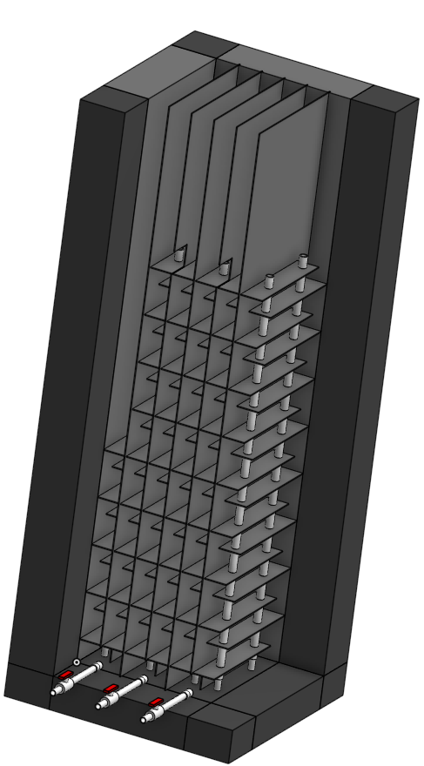
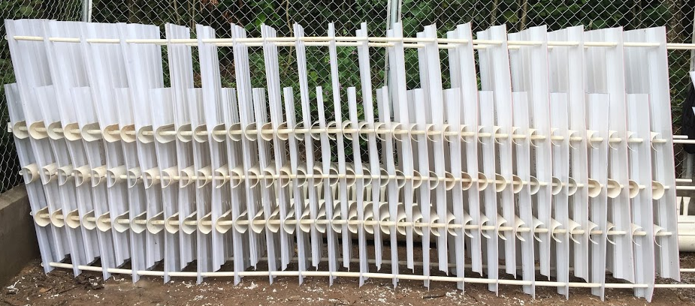
Meet the target H_{e}/S by decreasing the distance H between obstacles
This design was first used at the plant in San Juan Guarita in western Honduras
If it is hard, then it might not be the right solution…
We now have an alternative geometry, the Vertical-Horizontal Flocculator
Notes:
We now have an alternative design

Slide 16
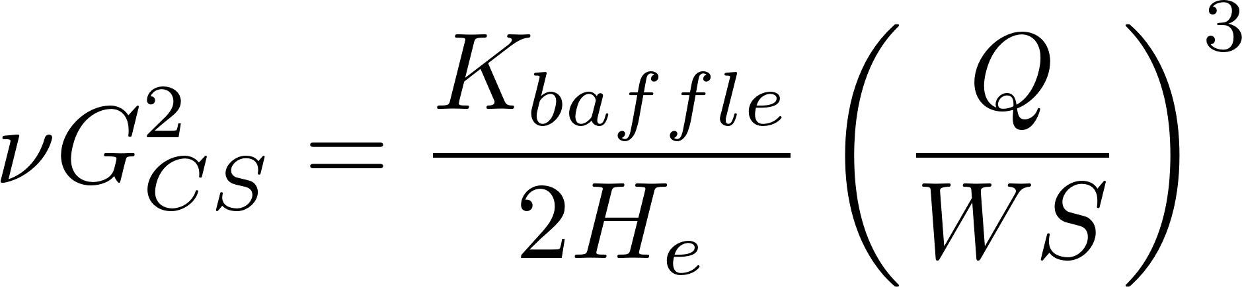
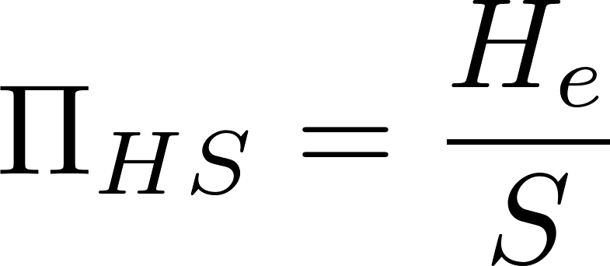
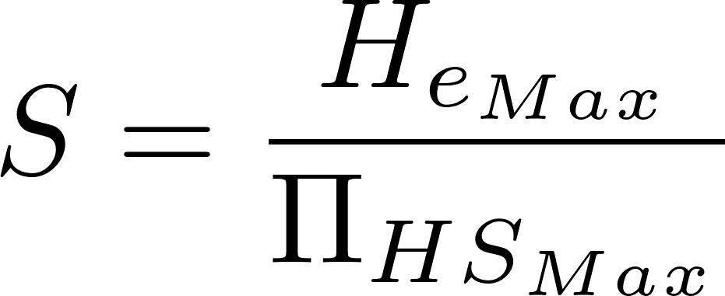
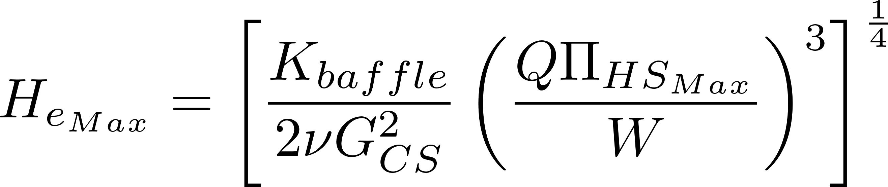
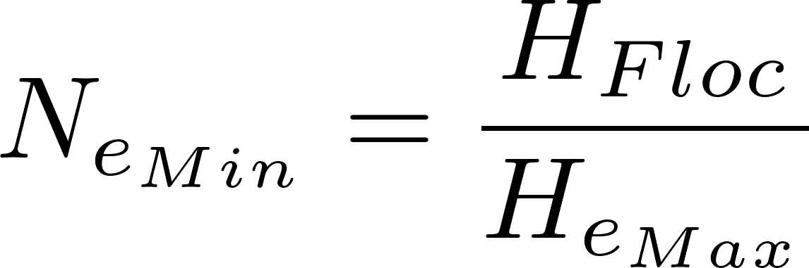
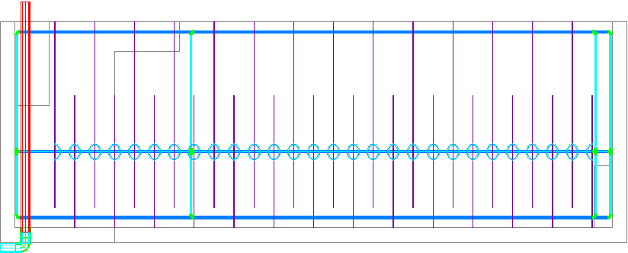
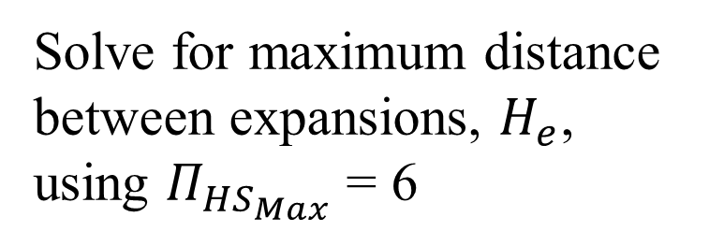
Minimum number of expansions per depth of flocculator (given W)
Eliminate S
Solve for maximum distance between expansions, $H_{e}$, using $Π_{HS_{Max}}$ = 6
Water depth at the end of the flocculator
Round up to get the minimum number of expansions per depth of the flocculator
Distance between flow expansions

Slide 17
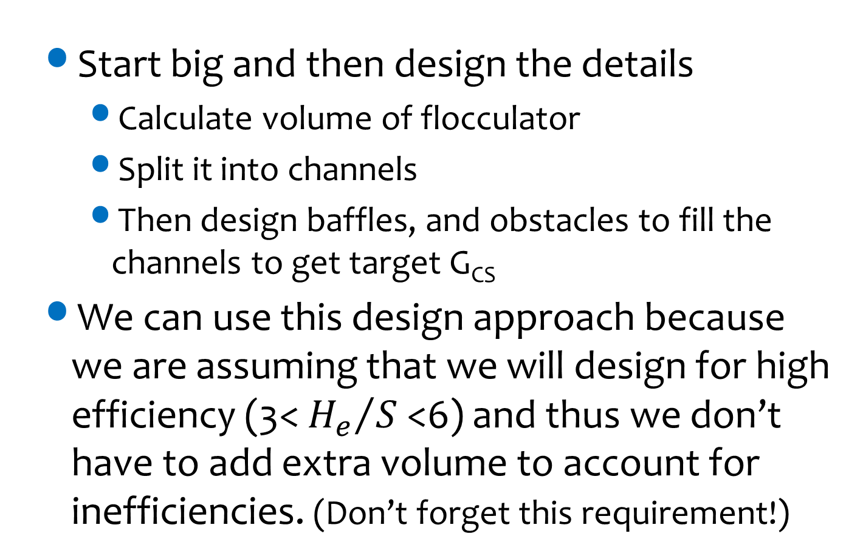
Our Design Approach Given G_{CS} and G_{CS}θ
Start big and then design the details
Calculate volume of flocculator
Split it into channels
Then design baffles, and obstacles to fill the channels to get target G_{CS}
We can use this design approach because we are assuming that we will design for high efficiency (3< ${H_{e}}/S$<6) and thus we don’t have to add extra volume to account for inefficiencies. (Don’t forget this requirement!)

Slide 18
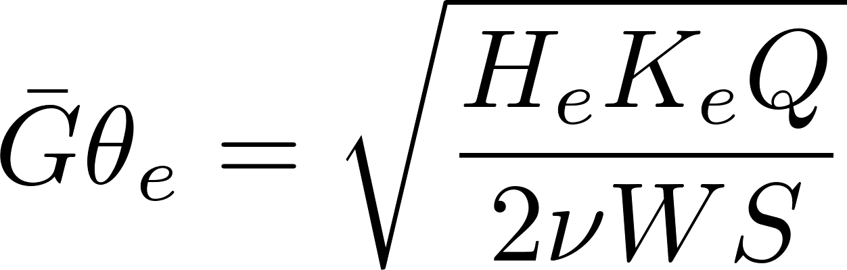
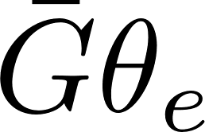
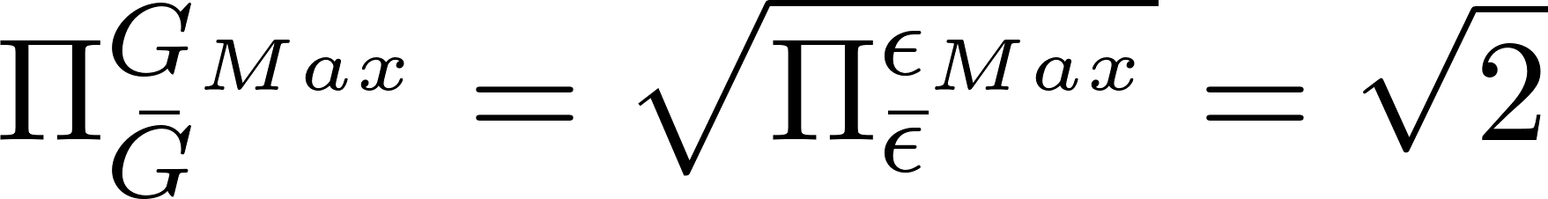
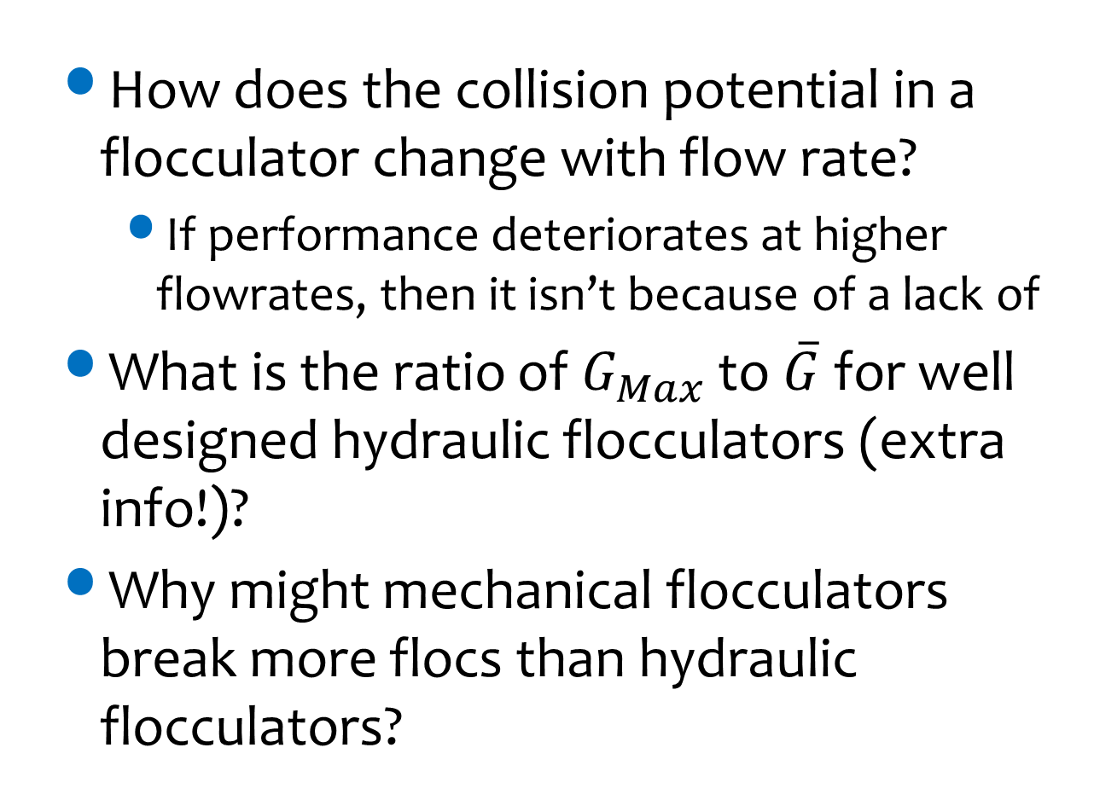
Reflection Questions
How does the collision potential in a flocculator change with flow rate?
If performance deteriorates at higher flowrates, then it isn’t because of a lack of
What is the ratio of $G_{Max}$ to $\overline{G}$ for well designed hydraulic flocculators (extra info!)?
Why might mechanical flocculators break more flocs than hydraulic flocculators?
Notes:
If we decrease flow, then Gtheta decreases!!!!
For small H/S need to take the average energy dissipation rate and multiply by 2 to get the max.
Mechanical flocculators have much higher ratio of Gmax to Gave.

Slide 19
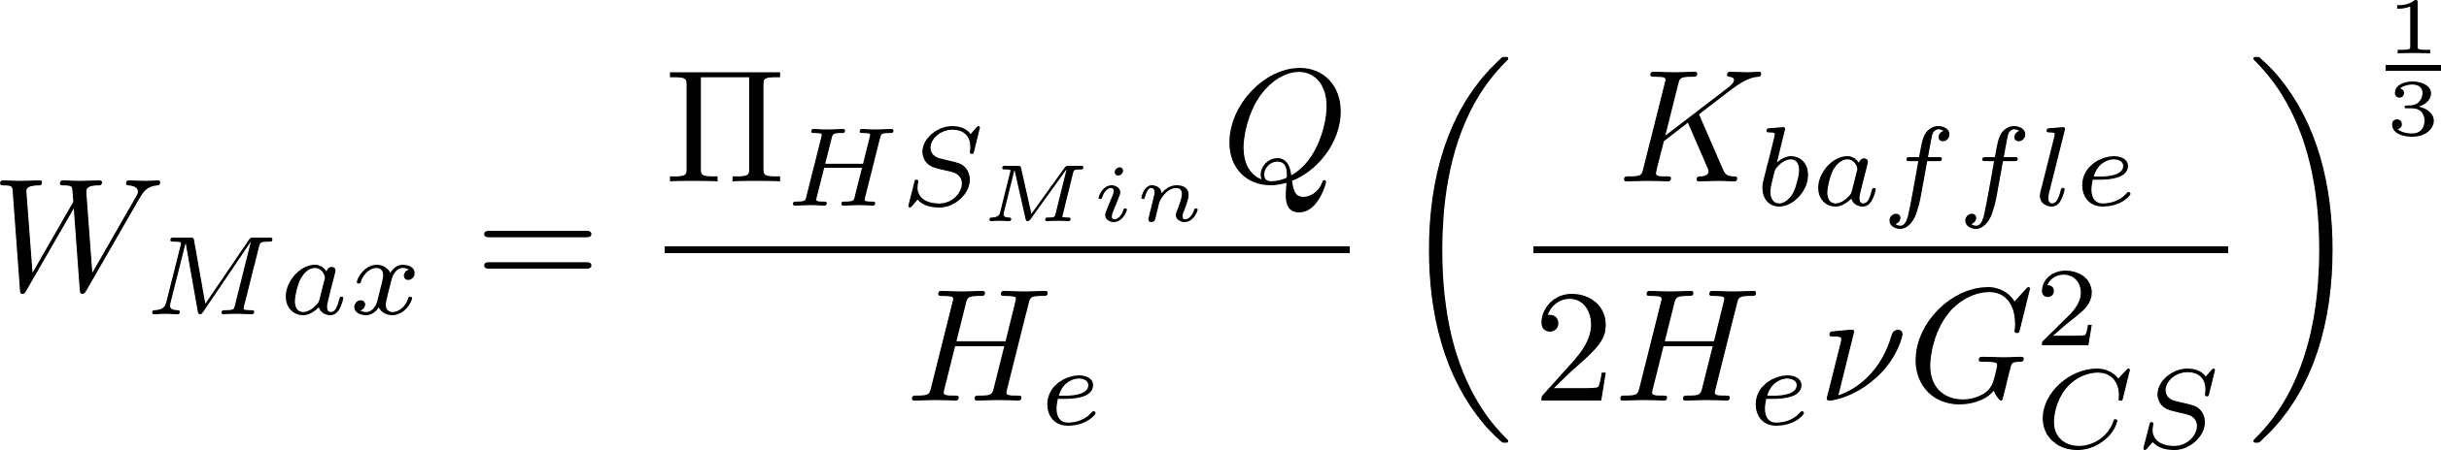
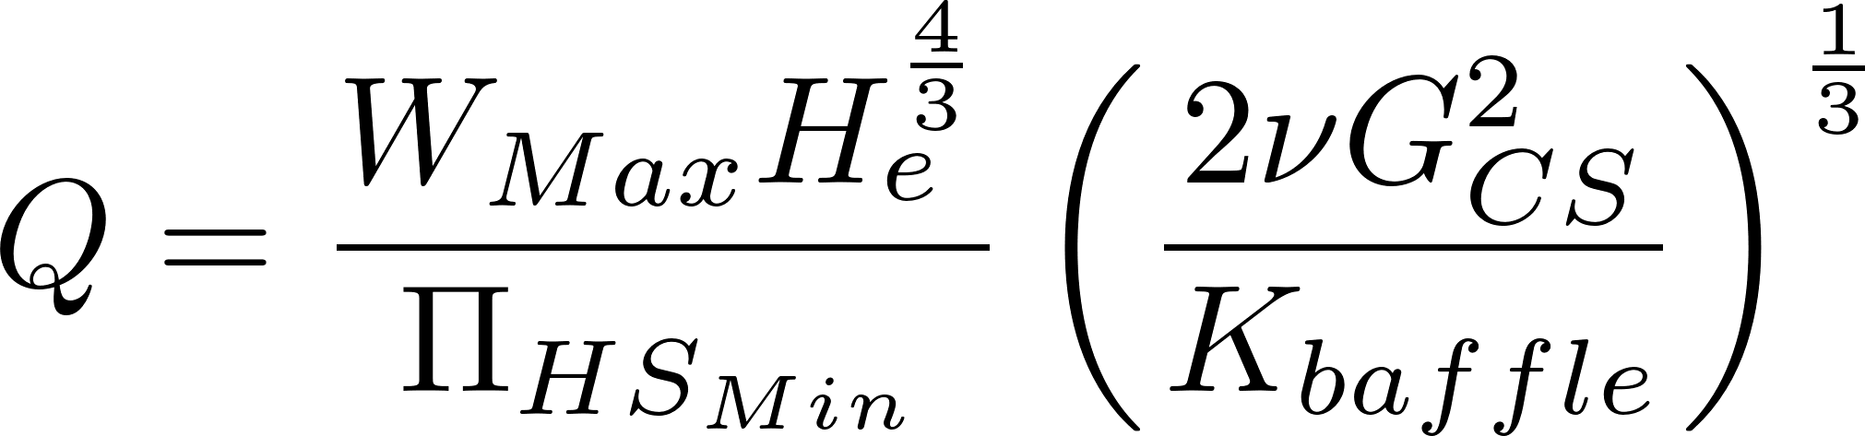
Maximum Flow for Horizontal-Vertical Flow Flocculators
Start with the equation for maximum channel width for vertical flow
This width is set by materials available to build the baffles
Solve for Flow
We can increase the maximum flow by increasing the depth of the flocculator

Slide 20
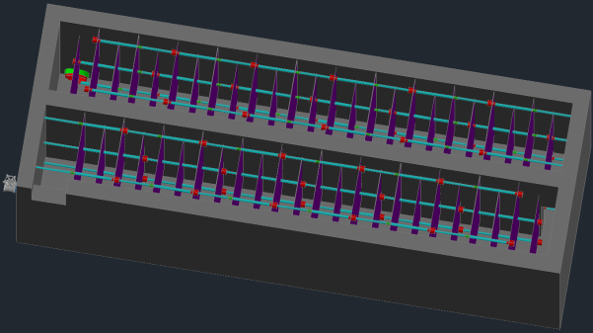
More details
The ports between channels should have the same cross sectional area as WS
The number of chambers (spaces between baffles) per canal (except in the last canal) is even – the number of baffles is odd
The number of chambers in the last canal is odd – the number of baffles is even
Why?

Slide 21
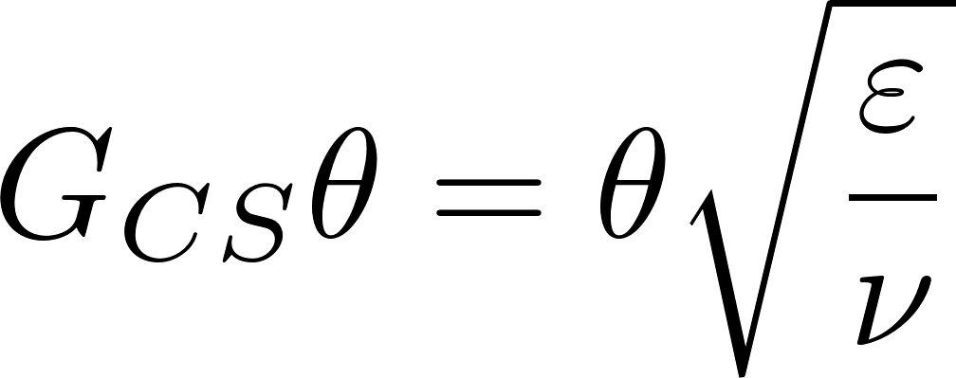
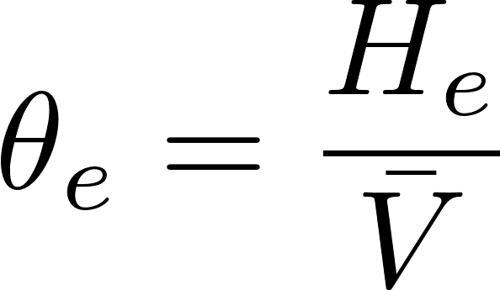
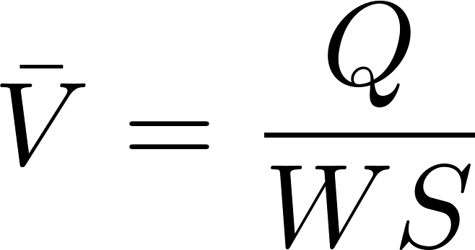
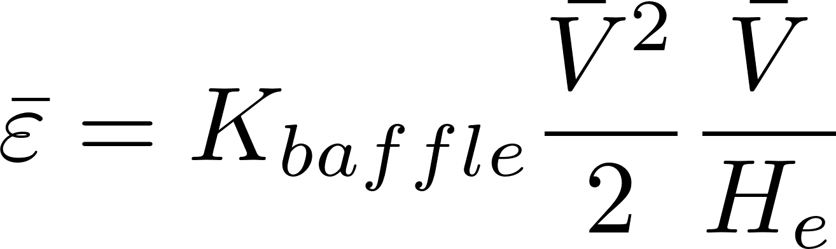
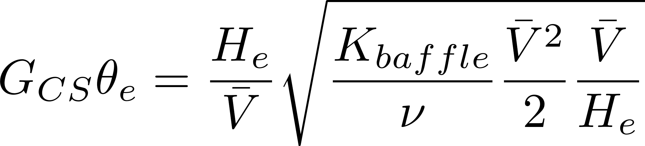
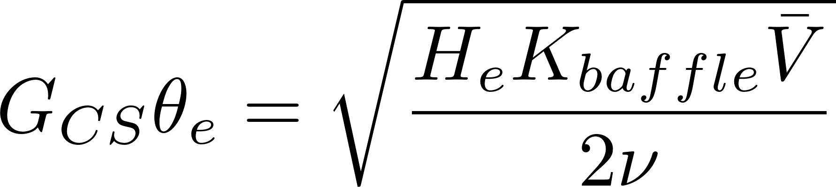
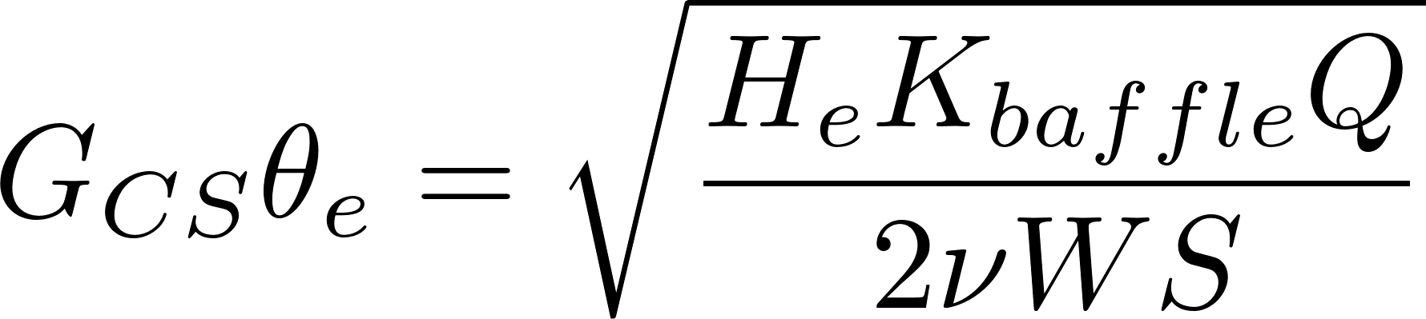
Collision Potential per Flow Expansion (bottom-up perspective)
Collision potential for one flow expansion
Height of one expansion zone (in a vertical flow flocculator)
Hydraulic residence time for one expansion zone
These are the average velocities through the expanded flow area
Energy dissipation rate is energy loss per time
Collision potential is a function of velocity. This suggests that a flocculator will perform worse when the flow rate is decreased.

